Slide 1
optical flow
Lecture 2.

Slide 2
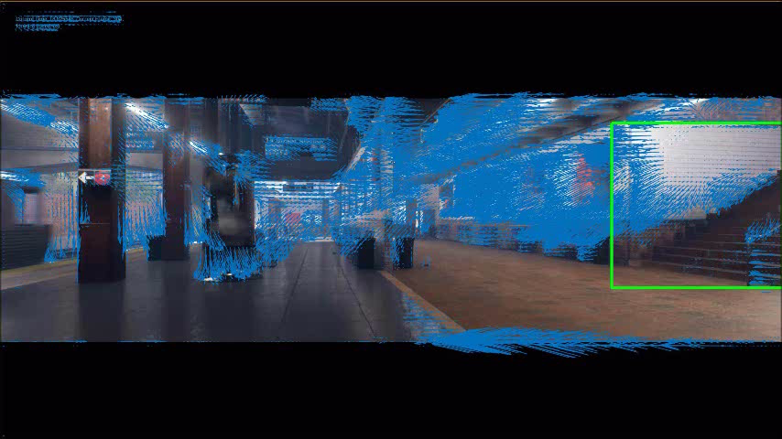
Perception in Motion
Optical Flow
Ex. Uses: motion detection, obstacle avoidance, action recognition
Ego-motion subtraction: Optical flow is greatly influenced by camera motion

Slide 3
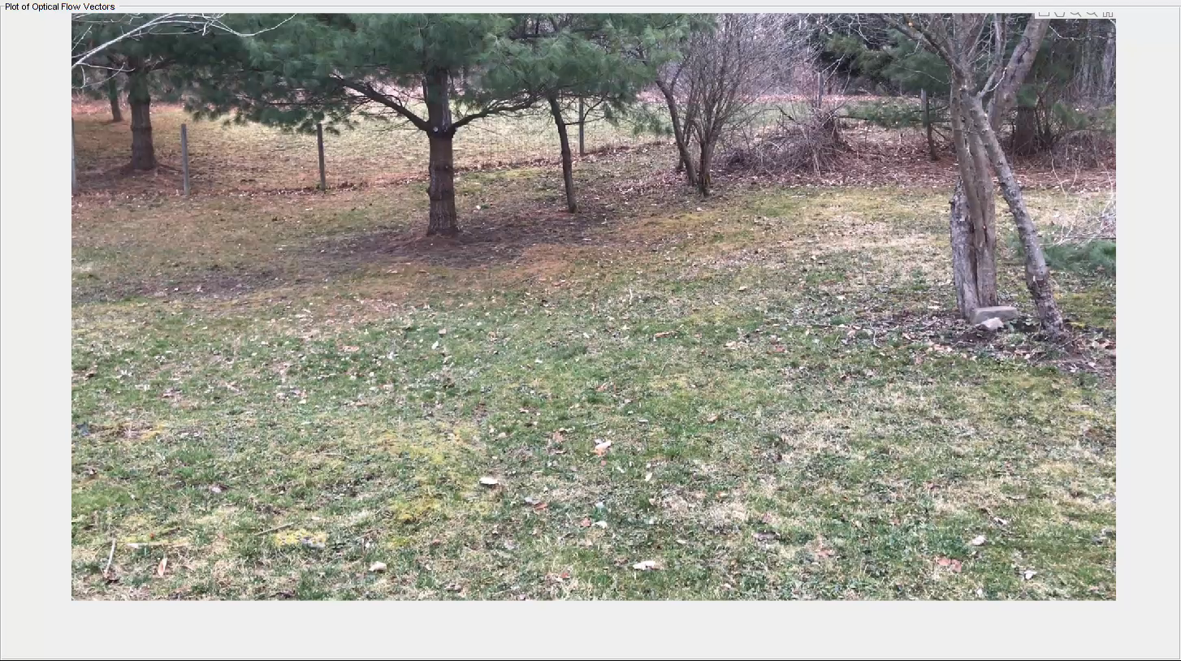
Perception in Motion
Optical Flow
Example Uses: motion detection, obstacle avoidance, action recognition
Ego-motion subtraction: Optical flow is greatly influenced by camera motion

Slide 4
optical flow
Stationary Camera
References:
[1]B.K.P. Horn and B.G. Schunck, "Determining optical flow." Artificial Intelligence, vol 17, pp 185–203, 1981. Manuscript available on MIT server.
[2] Computer Vision System Toolbox User’s Guide.

Slide 5
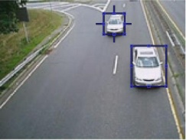
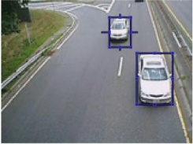
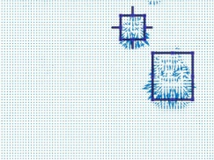
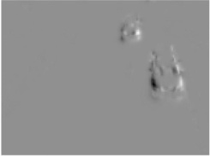
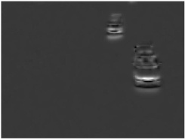
HOF Features
(a)
(b)
(c)
(d)
(e)
Courtesy of Pingping Zhu: Optical flow: (a) (b): a pair of consecutive video frames with the area round two moving vehicles outlined with two blue rectangles. (c): a close-up of dense optical flow in the outlined area; (d): horizontal component of the displacement vector field (higher intensity corresponds to positive values, lower intensity to negative values). (e): vertical component.

Slide 6
Example: HOF Extraction
Brightness Constraint
Consider video frames I(x,y,t), the brightness of particular point in the pattern is constant when the pattern moves in the frames, such that
where x, y and t are coordinates and time, respectively.
The terms and are velocities of pixel in x-axis and y-axis.
Smoothness Constraint
Consider neighboring points on the objects have similar velocities and the velocity field of the brightness patterns in the frame varies smoothly almost everywhere. The smoothness constraint is represented by minimizing the sum of squares of the Laplacians of the x- and y-components of the flow.

Slide 7
Horn-Schunk Method
Constrained Minimization Problem (Lagrange Multipliers):
By assuming that the optimal flow is smooth over the entire frame, the Horn-Schunck method computes an estimate of velocity field, [u,v], that minimizes the cost function
Equivalent Minimization Problem:
The above minimization problem is equivalent to minimizing:
Differentiate with respect to u and v to and set the derivatives to be zeros,

Slide 8
Horn-Schunk Method
Estimations:
The derivatives of brightness from I(x,y,t) are expressed by,
The Laplacians of u and v are expressed by
where the local average and are defined as
Notes:
i and j are the indexes of the pixels and k is the index of

Slide 9
Horn-Schunk Method
Iterative Solution
It is very costly to solve these nonlinear equations simultaneously by one of the standard methods, such as Gaussian-Jordan elimination, because the corresponding matrix is sparse and very large. Therefore, the following iterative method is applied to solve the equations for [u,v].
Rewrite the equations as,
Then, a new set of velocity estimates (u^{n+1} , v^{n+1}) at the (n+1)^{th} iteration are calculated recursively from the estimated derivatives and the average of the previous velocity estimates (u^{n} , v^{n}) by

Slide 10
Horn-Schunk Method
MATLAB Implementation: opticalFlowHS
Read in a video file.
vidReader = VideoReader('viptraffic.avi');
Create optical flow object.
opticFlow = opticalFlowHS;
Estimate the optical flow of objects in the video.
while hasFrame(vidReader)
frameRGB = readFrame(vidReader);
frameGray = rgb2gray(frameRGB);
flow = estimateFlow(opticFlow,frameGray);
imshow(frameRGB)
hold on
plot(flow,'DecimationFactor',[5 5],'ScaleFactor',25)
hold off
end

Slide 11


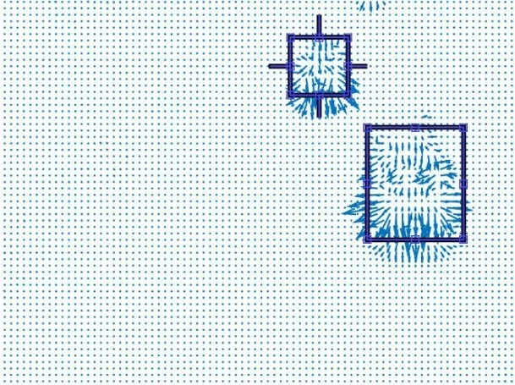
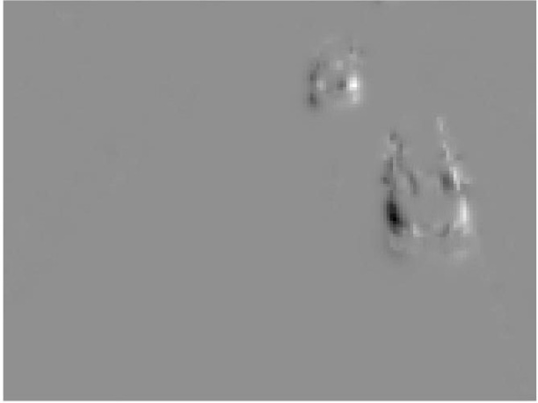
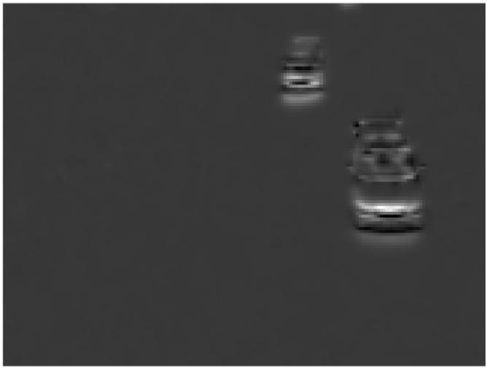
Example: Optical Flow
Results and Figures
(a)
(b)
(c)
Optical flow: (a) (b): a pair of consecutive video frames with the area round two moving vehicles outlined with two blue rectangles. (c): a close-up of dense optical flow in the outlined area; (d): horizontal component of the displacement vector field (higher intensity corresponds to positive values, lower intensity to negative values). (e): vertical component.
(d)
(e)

Slide 12
Optical Flow: Horn-Schunk Method
References:
[1]B.K.P. Horn and B.G. Schunck, "Determining optical flow." Artificial Intelligence, vol 17, pp 185–203, 1981. Manuscript available on MIT server.
[2]Computer Vision System Toolbox User’s Guide.

Slide 13
Ego-motion subtraction
Moving Camera

Slide 14
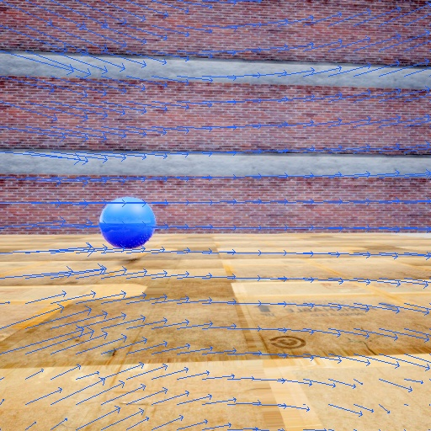
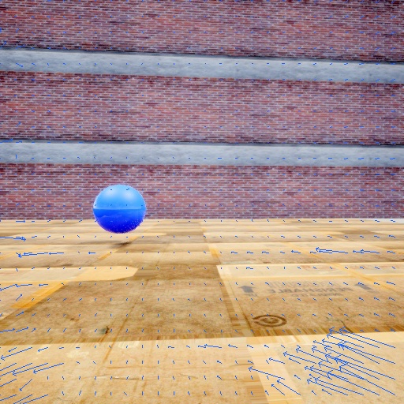
Ego-motion Subtraction
“Substracting” Known Camera Motion:
Optical flow can be generated by motion in the scene and/or by the camera motion. Ego-motion subtraction compensates for the camera motion to extract the flow only associated with the moving objects.
Example of ego-motion subtraction: (a) A pinhole camera moves in a static environment. (b) The optical flow induced by the camera motion is subtracted via the method that we will discuss later.
Optical flow calculated with OpenCV
Optical flow after ego-motion subtraction

Slide 15
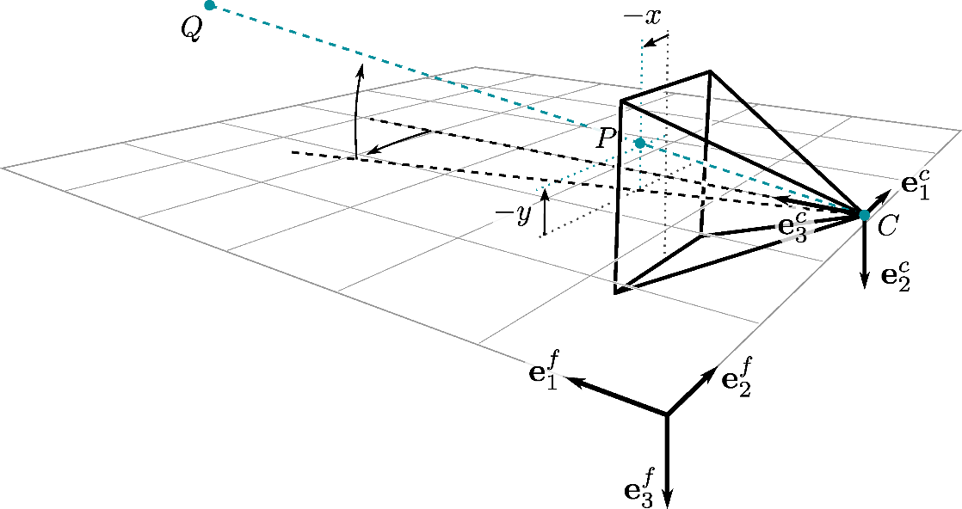
Ego-motion Subtraction: Pinhole Camera Model
Assuming a moving pinhole camera views a stationary point in the scene. The position vector of expressed in the sensor fixed reference frame is,
According to the camera model, is projected to the image plane at point . The position of it is expressed as,
The position vector can be written in terms of q, i.e.:
is focal length
are the coordinates in image plane

Slide 16
Ego-motion Subtraction: Optical Flow Induced by Camera Motion
The optical flow of the point caused by the ego-motion of camera can be calculated according to,
The velocity of point can be derived in terms of camera velocity and angular velocity ,
Substituting equation of into the optical flow equation yields the final expression,

Slide 17
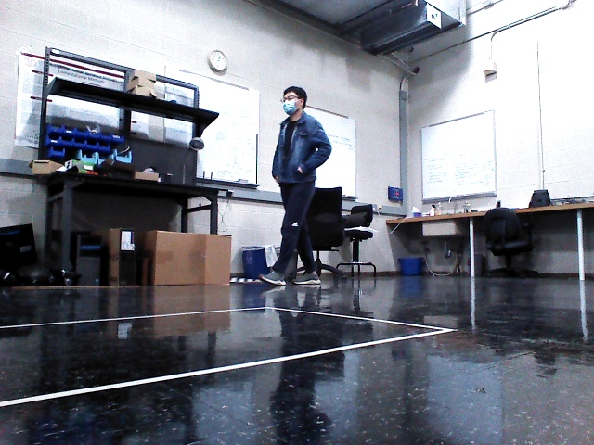
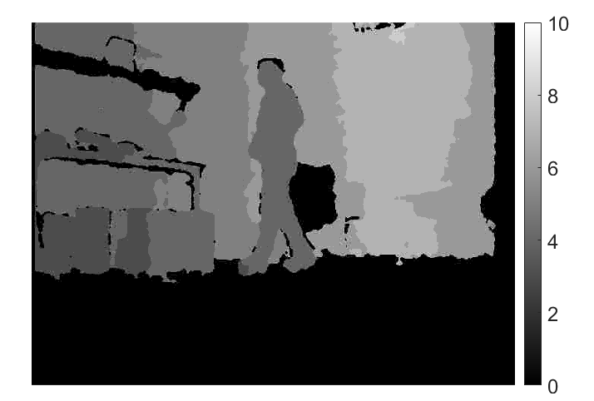
Ego-motion Subtraction: Requirements
The computation of the optical flow requires knowledge of camera motion, camera optical parameters, and depth of the scene.
Camera motion
Optical parameters
Depth
For ground vehicles (e.g., UGV, self-driving car), the camera motion can be estimated via onboard sensor (e.g., IMU, GPS). The depth map can be obtained by depth sensor, for instance, stereo camera and Lidar.
Example: depth map obtained from a UGV
(a)
(b)

Slide 18
Ego-motion Subtraction
Finally, subtracting the computed flow from the total flow estimated by Horn-Schunk Method will compensate for the ego-motion of the camera.
Pseudocode: ego-motion compensation
Given the velocity v, angular velocity , and focal length of the camera and image size
1. calculate matrices H and G
2. Estimate the optical flow by calculating,
3. Subtract the flow from total flow estimated by the Horn- Schunk method
Calculate each component of H and G by plug in , and

